Slide 1

Small Office Network Design with Packet Tracer
Explore VLAN and DHCP implementation for efficient networking.
Names :
Malak Ossama Sobeih
Ather Ahmed
Ahmed Ali
Ahmed Youssry
Abdelmagid Azab

Slide 2

Small Office Network Challenges
Imagine a three-story office building with four departments, each situated on a different floor. Our challenge was to design a secure and efficient network infrastructure to meet their unique needs.
Each floor had its own switch, serving as the central hub for devices within the department. We needed a way to segregate network traffic and enhance security, preventing unauthorized access between departments. The solution? VLANs (Virtual Local Area Networks).
By assigning each department its own VLAN, we could allow devices within that department to communicate freely, while isolating them from other departments. VLANs provided an additional layer of security by preventing sensitive information from leaking between departments.
This solution not only enhanced security but also improved network performance by reducing broadcast traffic. To simplify device configuration and management, we implemented DHCP (Dynamic Host Configuration Protocol).
DHCP automatically assigned IP addresses to devices within each VLAN, eliminating the need for manual configuration and
streamlining network administration.

Slide 3

Packet Tracer Overview
1
Network Simulation Tool
2
Real-world Scenarios
3
Learning Platform
Create and troubleshoot complex network topologies.
Ideal for students and professionals practicing networking concepts.
Cisco's software for virtual network design and testing.

Slide 4




Small Office Network Components
Switches
End Devices
Router
Connects different network segments and manages traffic flow.
Connects devices within the same network segment.
Computers, printers, and other networked equipment.

Slide 5
Understanding VLANs
Definition
Benefits
Implementation
Virtual LANs segment network logically, not physically.
Improved security, performance, and network management.
Configure VLANs on switches using Packet Tracer.

Slide 6

VLAN Configuration Steps
1
Create VLANs
Define VLANs on switch using VLAN database. in this project we create four VLANs for four departments (IT, HR, Sales, Finance)
2
Assign Ports
Associate switch ports with appropriate VLANs.
3
Configure Trunks
Set up trunk links between switches.
4
Inter-VLAN Routing
Enable communication between VLANs using router.

Slide 7
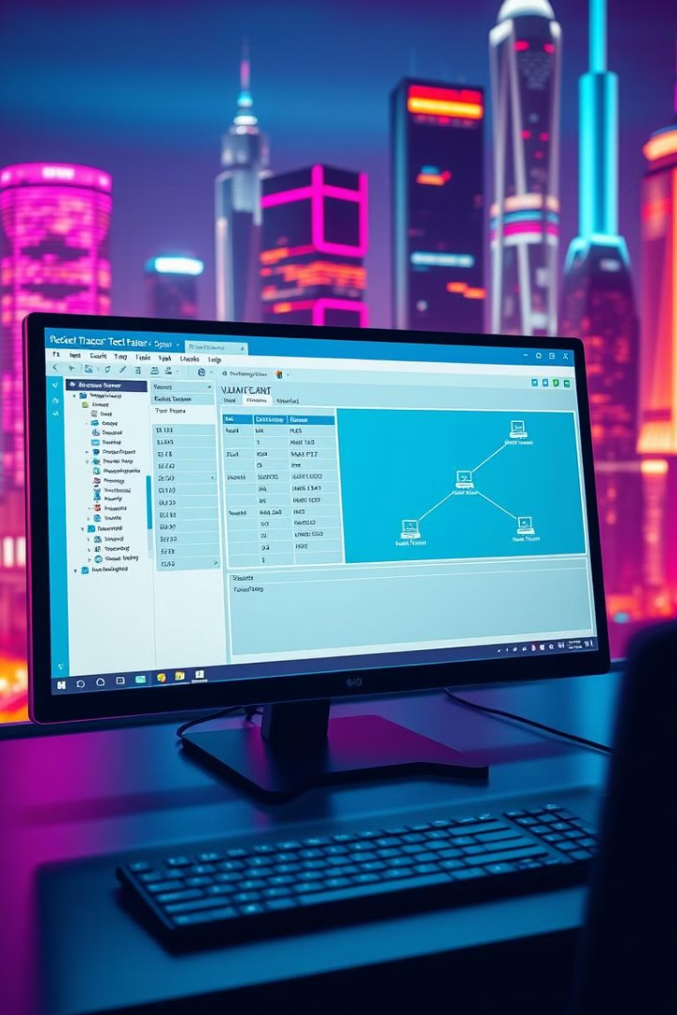
VLANs created
1
VLAN 10
2
VLAN 20
for IT department
for HR department
IP range : 192.168.10.0/24
IP range : 192.168.20.0/24
Gateway : 192.168.10.200
Gateway : 192.168.20.200
Range of ports :
Range of ports :
0/1- 0/5
0/6- 0/10
3
VLAN 30
4
VLAN 40
for Sales department
for Finance department
IP range : 192.168.30.0/24
IP range : 192.168.40.0/24
Gateway : 192.168.30.200
Gateway : 192.168.40.200
Range of ports :
Range of ports :
0/11- 0/20
0/21- 0/24

Slide 8

DHCP Basics
Dynamic Host Configuration Protocol
Automates IP address assignment to network devices.
DHCP Server
Manages IP address pool and lease information.
DHCP Client
Devices requesting IP addresses from DHCP server.
Lease Time
Duration for which IP address is assigned.

Slide 9
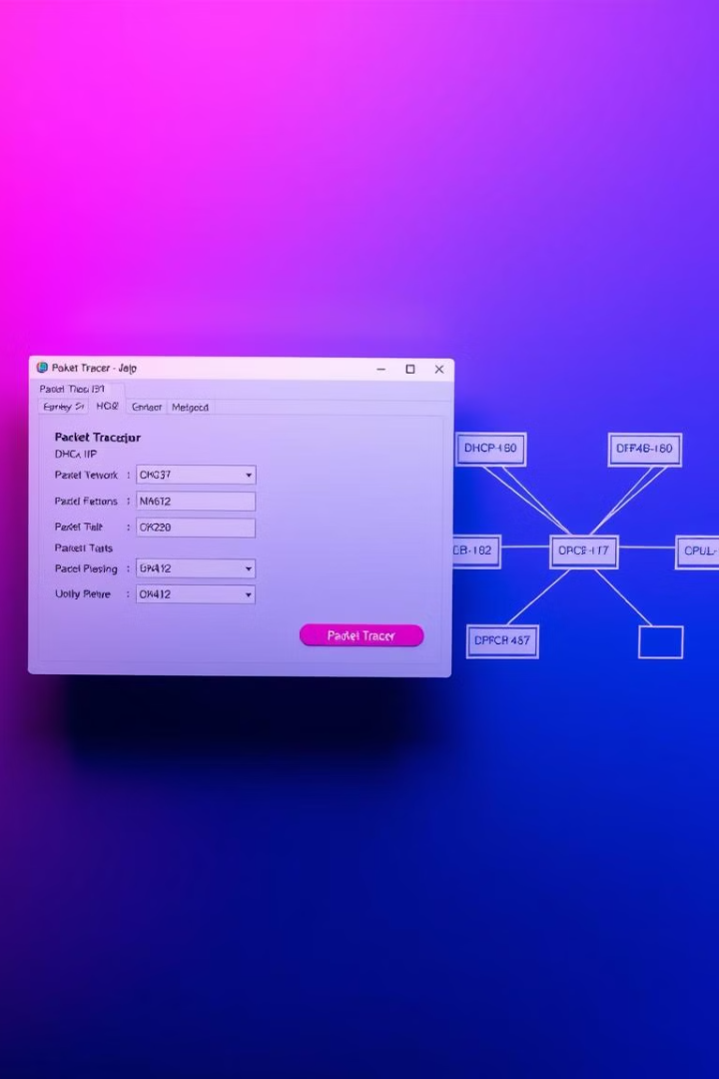




Implementing DHCP in Packet Tracer
Configure DHCP Server
Set up DHCP pool on router or server.
Define DHCP Scopes
Specify IP ranges for each VLAN.
Enable DHCP on Interfaces
Activate DHCP on router interfaces for VLANs.
Verify Configuration
Test DHCP functionality using Packet Tracer simulations.

Slide 10

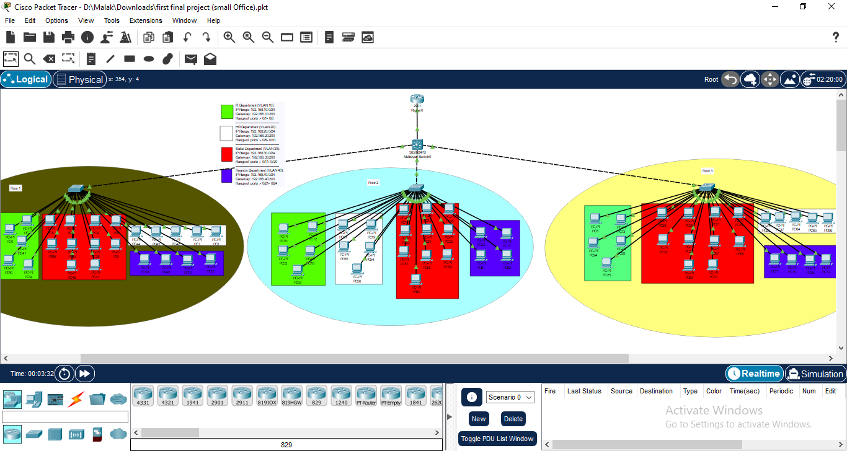
packet tracer project

Slide 11

Testing and Troubleshooting
Command
Purpose
show vlan
Verify VLAN configurations
show ip dhcp binding
Check DHCP address assignments
ping
Test connectivity between devices
tracert
Analyze network path

Slide 12

Thank you!
Any questions?

